Slide 1
The Opioid Crisis in the United States of America
Brevin Lacy, Matthew Lyons, Kathi Munoz-Hofmann, Neelie Shah
Notes:
Brevin:
Introductions: the presenters are Brevin Lacy, Matthew Lyons, Kathi Munoz-Hofmann, Neelie Shah
We chose to analyze the rapidly growing opioid crisis in the United States.

Slide 2
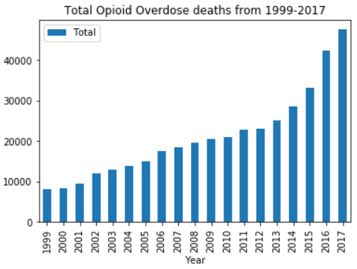
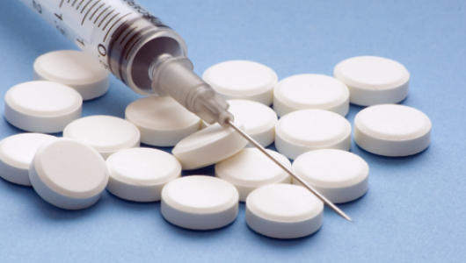
Project Summary and Reason for Pursuing
Opioid: a compound resembling opium in addictive properties or physiological effects
Opioid overdose death rate on the rise all throughout the United States
In 2017, number of deaths by opioid overdose exceeds both automobile casualties and firearm homicides
Notes:
Brevin:
First, for those who don’t know, I will start with a brief description of an opioid: a compound resembling opium in addictive properties or physiological effects. We will be specifically looking at the deaths due to opioids and how prescriptions of opioids have trended.
Our group understands this is a very morbid topic and isn’t necessarily a super comfortable. However, this crisis is very serious and we are passionate about finding out why tens of thousands of people are passing away as a result of taking these drugs. The rate at which people are dying, as shown by the graph to the right, is increasing exponentially, especially in the more recent years. In fact, in 2017, the number of deaths by opioid was greater than the number of automobile casualties as well as firearm homicides. This demonstrates the sheer magnitude of this issue and why we were captivated by this topic and why we set out to discover the reason it has been happening.

Slide 3
Original Goals
Identify possible causes, and perhaps find potential solutions
Determine probable impact on an individual based on a variety of factors
Meaningfully visualize overdoses by different categories:
Year
Age
Gender
Location
Race
Type
Economics
Compare peaks with real events
Trends over time
Trends by location
Notes:
Neelie
We started with the initial goal of really just wanting to understand the opioid crisis and figure out trends in data and possibly find a “solution”. In addition to this, we wanted to be able to find a good method of visualizing out data based upon different factors (the factors being year, age, gender, location/state, race, type of opiod, and socioeconomic background).

Slide 4
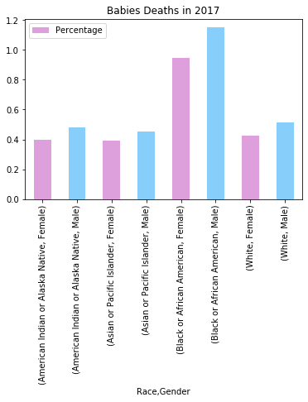
Distribution of Work
Each member inspected a different dataset
Worked on similar concepts but with different data
Around the middle, we considered branching off into a more general topic
Ultimately decided expanding our scope would be too much
Notes:
Neelie
Because our data set was distributed between four different sets (race, age range, gender, and type of opioid), we decided to split apart and have each person look at a different set of data. We found this to be a really good method within the first couple weeks since there was a lot to explore within these datasets. However, as the weeks went along, we really wanted to find a way to combine our sets so we could try doing k means or a meaningful decision tree. This proved to be impossible so we opted to have half of our group try and broaden the scope by focusing on overall deaths grouped by age, race, gender and location. Although some interesting finds came about this method, we ultimately decided it was too broad a scope since we couldn’t fit this into our current ‘story’.

Slide 5
Processes Used
Preprocessing
Searched for datasets
Cleaned datasets
Analysis
Analyzed data using pandas
Searched through the news for possible causes
Visualization
Visualized data using matplotlib and geopandas
Models
Worked briefly with decision trees, naïve bayes
Notes:
matthew
To achieve our project goals, we employed several process covered in class. We searched for datasets online, both with the provided links and via Google. After downloading them, we also had to perform a small amount of cleaning to get the data into a pandas-ready format. This typically consisted of manually removing headers and notes from csv files.
We analyzed the data using pandas, much like how we did it in class. We loaded csv files into dataframes and used various means of grouping and manipulation to attempt to glean meaning from them. We also searched for news articles online that corresponded with notable time periods, to attempt to explain some of the phenomena we encountered.
We used pandas, matplotlib, and geopandas to visualize the data in a variety of forms, including bar charts, line graphs, scatter plots, bubble plots, and U.S. maps. This also helped us to extract meaning and craft stories around the data.
We spent a moderate amount of time trying to make decision trees and naive bayes work for us, but the format of our data largely didn't support it, so we found they didn't particularly enhance our understanding of the datasets.

Slide 6
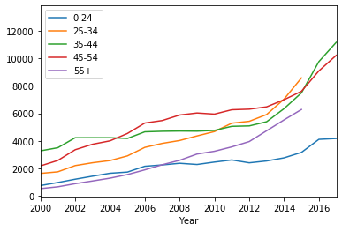
Results: Age
Notes:
Matthew
The grand takeaway when looking at the data by age group is that the people overdosing are primarily middle-aged (~40-50), presumably due to easier access. Young people don't tend to overdose frequently, nor do extremely old people. The 25-34 group took the top spot in 2014 and 2016, but due to a NaN datapoint in 2015 it isn't visualized on the graph.

Slide 7
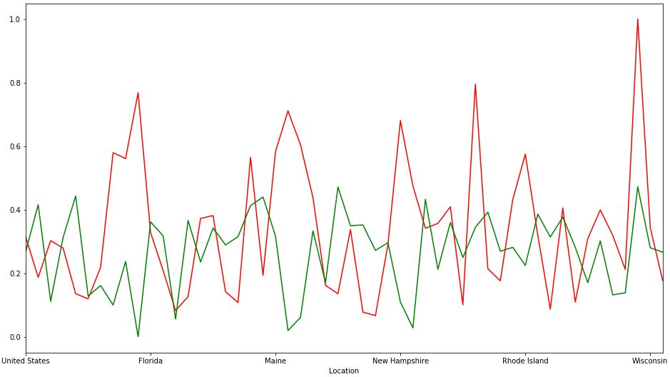
Results: Economics
In general, median household income and death by opioid rate follow a similar trend
Red: Normalized Opioid Related Death Rate
Green: 1 - Normalized Median Household Income
Less wealthy states tend to have higher rates of opioid overdoses
Notes:
Brevin:
I would first like to apologize for the ambiguity on the x-axis. I found that this graph displays the results and contrasts the different states well but I could not find a solution for the lack of detail on the x-axis. So, in order to provide some clarity, just know that the states are in alphabetical order from left to right.
While doing some research prior to analyzing our data, I found some sources that stated wealth might have a correlation to the amount of deaths by opioid overdose. For this reason, I decided to look into this possible correlation. I plotted both the normalized opioid related death rate (red) and the normalized lack of median income (green: 1 - the normalized median household income) on the plot shown to the right. While there are a few outliers where the red line greatly exceeds the green line, in general, they follow a very similar trend.
The conclusion I can take from this data, similar to what was mentioned in the articles I researched, is that in general states with a higher wealth have lower opioid overdose rates which is evidence for the hypothesis that opioid addiction trends toward lower economic classes. Therefore, when trying to determine a solution for this crisis and when creating legislation, it would be smart to cater the support of opioid addicts to those with less wealth because they are more likely to overdose on these drugs.
Note: to normalize my data, I divided each entry by the max value of that attribute in order to overlay the two data sets on the same range (0, 1). That way the two variables were more comparable while maintaining the magnitude of each data point.

Slide 8
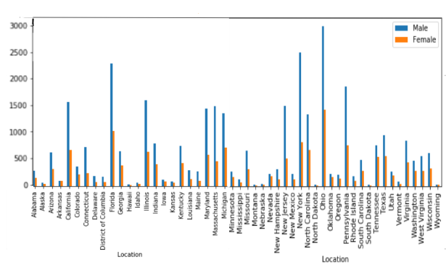
Results: Gender, 2017 (most recent)
Notes:
Kathi
When beginning to look at overdoses by gender, I began by looking at the most recent data. The most recent data that we had was for the year 2017, so I made a simple bar chart to get an overall look at it. Probably the first thing we notice is the fairly universal trait of more male than female overdoses in every state. This made me wonder about the overall amount of men versus women in the US, and whether that might be contributing to this trend. However, it turns out that in the US there are actually more women than men.
In fact, when I dug into this in other places, I found that this trend is not unique to opioids. According to the National Institute of Health, men are more likely than women to use almost any type of illicit drugs, which helps validate what this graph shows.

Slide 9
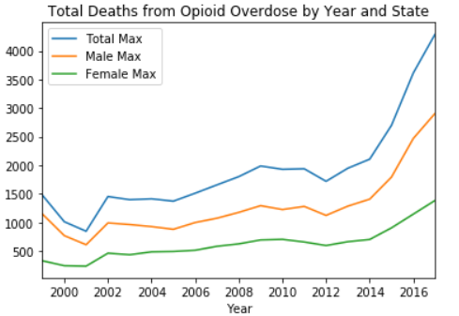
Results: Gender, overdoses on the rise
Notes:
Kathi
Additionally, of course we wanted to look at trends over time. So here we have the total overdoses over all as well as for males and females across the whole of our data: from 1999-2017. Overall, what this graph shows me is the growing problem of opioid abuse in the United States. Particularly, the recent surge of the problem. The opioid crisis has apparently been ongoing since around the 90’s but this data shows without a doubt the rather startling spike in overdoses of recent years. Indeed, multiple studies are showing that with development of new kinds of opioids, the problem is meeting new accelerators, something that will be highlighted further later on.
Another observation I make from this plot is how closely the data for males follows the data for the total. It almost looks as though the data for males could be a simple transformation downward by 500-1000 give or take. As such, it seems that the trend for overdosing in males is indicative of the trend for the US as a whole. This is somewhat intuitive, seeing as males account for the majority of overdoses.
In terms of postulating some ways to address the opioid crisis, this graph indicates that perhaps targeting men could be a worthwhile strategy.

Slide 10
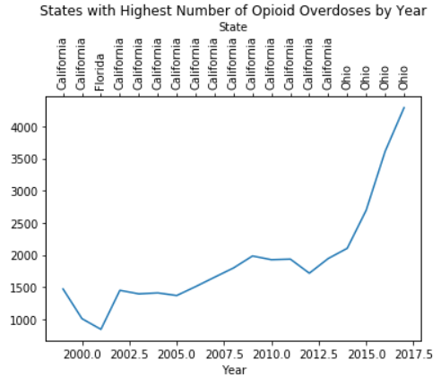
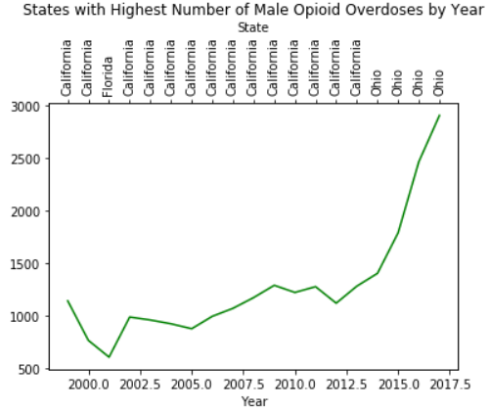
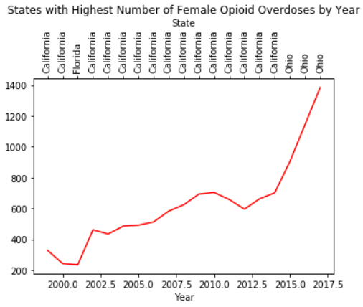
Results: Gender - The worst states
Notes:
Kathi
Here we have which states had the most number of overdoses for each year in our datasets overall, for males, and for females. All three of them look quite similar, indicating that the rate at which the crisis may not be that different even if the numbers for males are larger. Again, we see a fairly steady rise overall, but a startlingly sharp rise from about 2012 on.
Probably the main takeaway we have here is the movement of the opioid crisis. Initially, the problem seems fairly rooted in the West coast - California specifically. However, in 2012 there is an abrupt shift to Ohio. This shows a shift of the crisis over from the west coast over to the east coast. This is a natural trend for most movements in the US, to begin on the West Coast and generally diffusing over to the east coast. What I find interesting is the drastic increase in overdoses that came along with the shift to Ohio. Regardless of the reasons for that, this indicates that perhaps Ohio needs to devote more infrastructure to programs in this area.

Slide 11
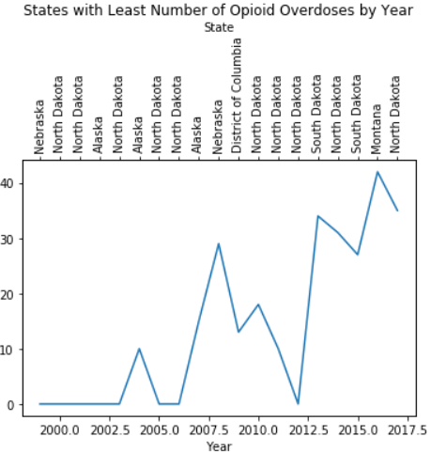
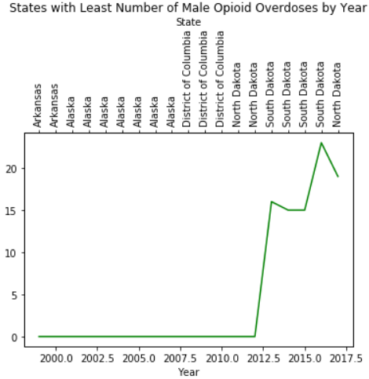
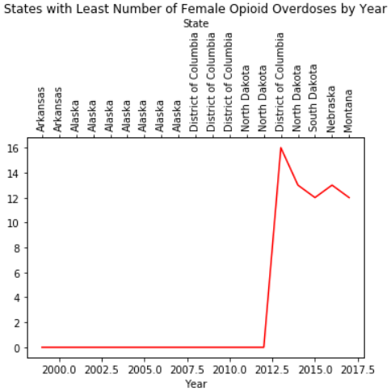
Results: Gender - The worst states
Notes:
Kathi
This is the same graph as the previous slide, but now it details the minimum states for total overdoses. Again, this shows just the overall growth of the problem. We move from having virtually no deaths as the minimum to having at least a few. So many of the values are zero mostly to insufficient data for that year, but the result is still comparable. The west to east coast trend is not as drastic here but still generally followed.

Slide 12
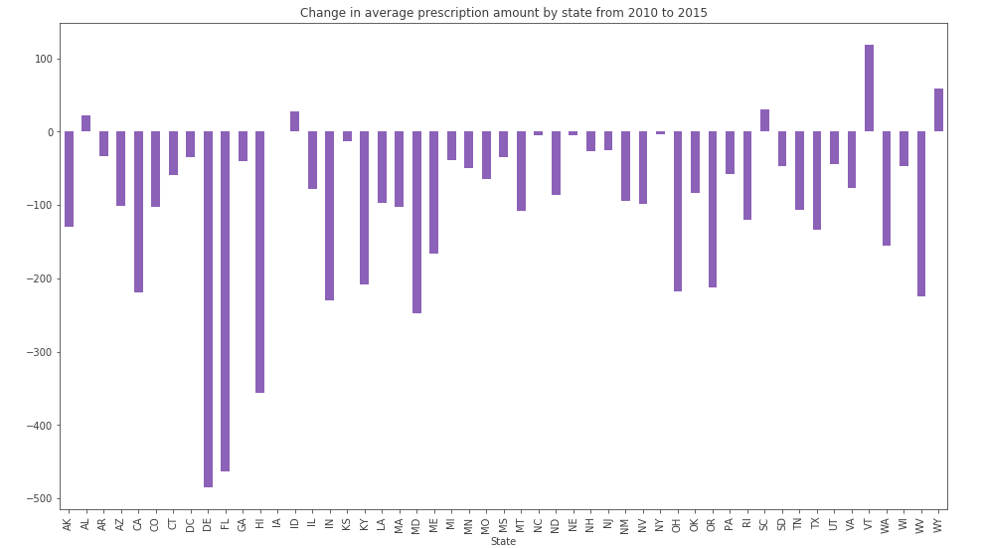
Results: Location
Notes:
matthew
The graph on this slide illustrates the change in opioids prescribed by state from 2010 to 2015. It's very evident that the amount dropped drastically overall across nearly all states. The map on the next slide illustrates this more clearly.

Slide 13
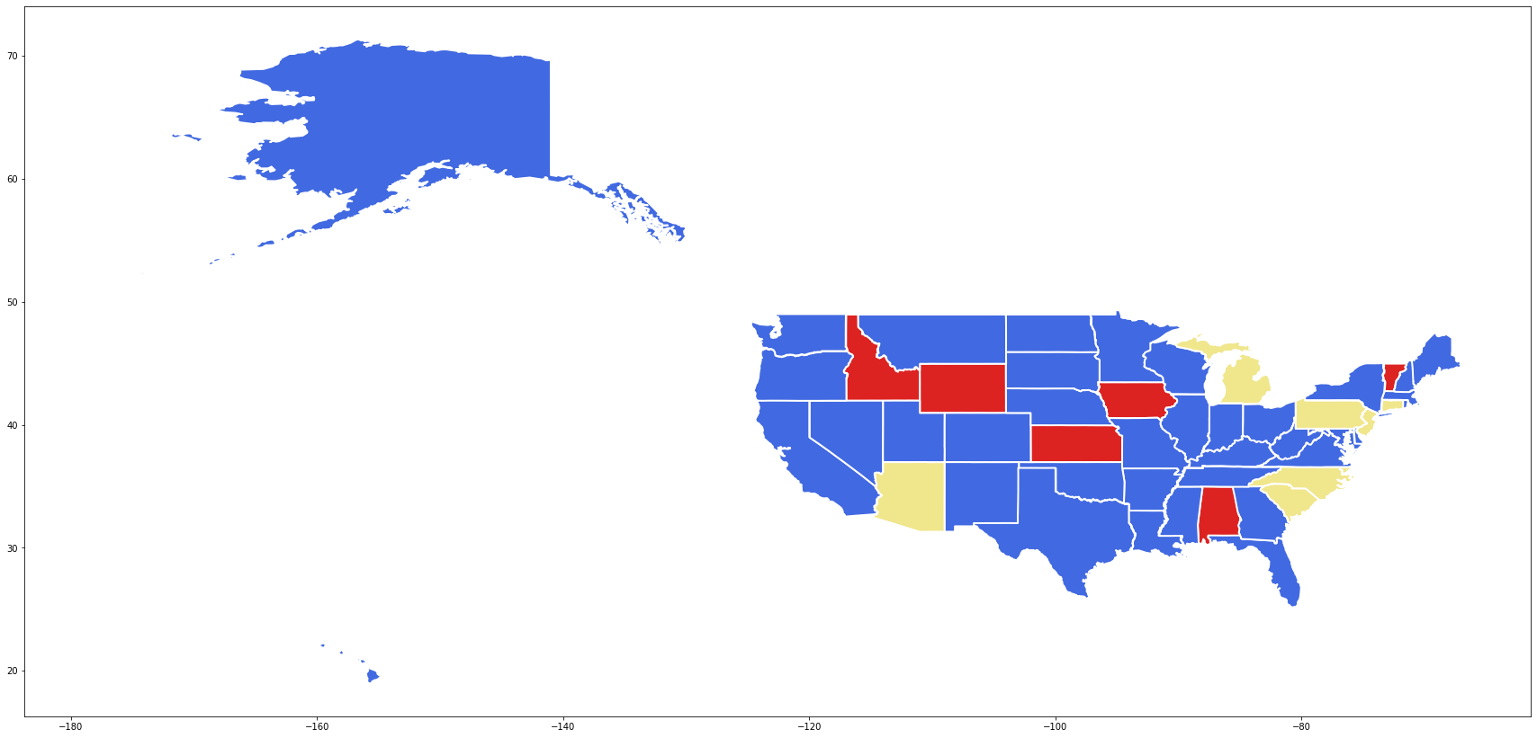
Results: Location
Notes:
matthew
The amount prescribed decreased in blue states, increased in red states, and remained approximately the same in yellow states. As we can see, it dropped nearly everywhere, both east and west. However, as we will see next, this trend does not extend to total overdose amount.

Slide 14
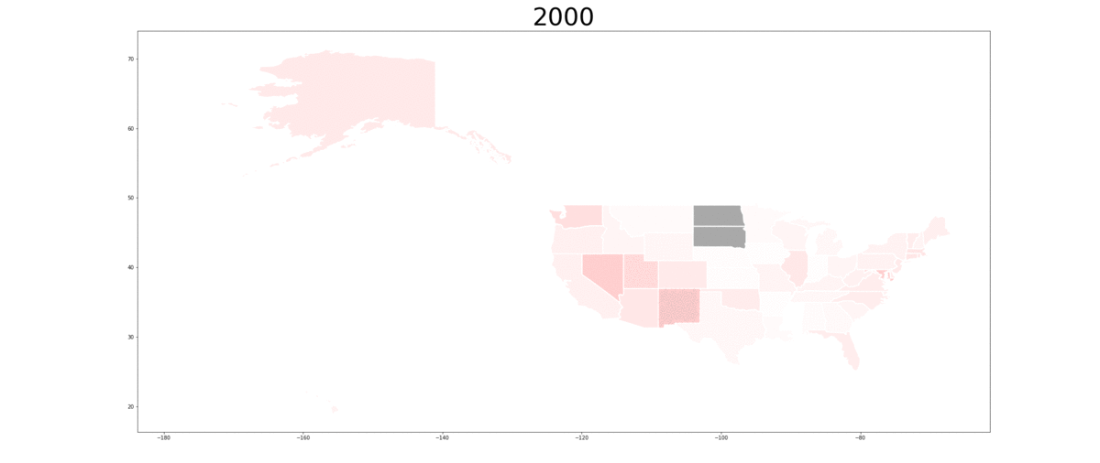
Results: Location
Notes:
matthew
This gif shows the rise of opioids between 2000 and 2017. We can see that in the first half, they predominantly grow in the west. However, in the latter half they take hold, starting in West Virginia and spreading outwards until they've taken over the eastern U.S.

Slide 15

Results: Location
Notes:
matthew
We can see here that in the beginning, opioids only really exist in the west. There are nearly none anywhere else in the United States.

Slide 16
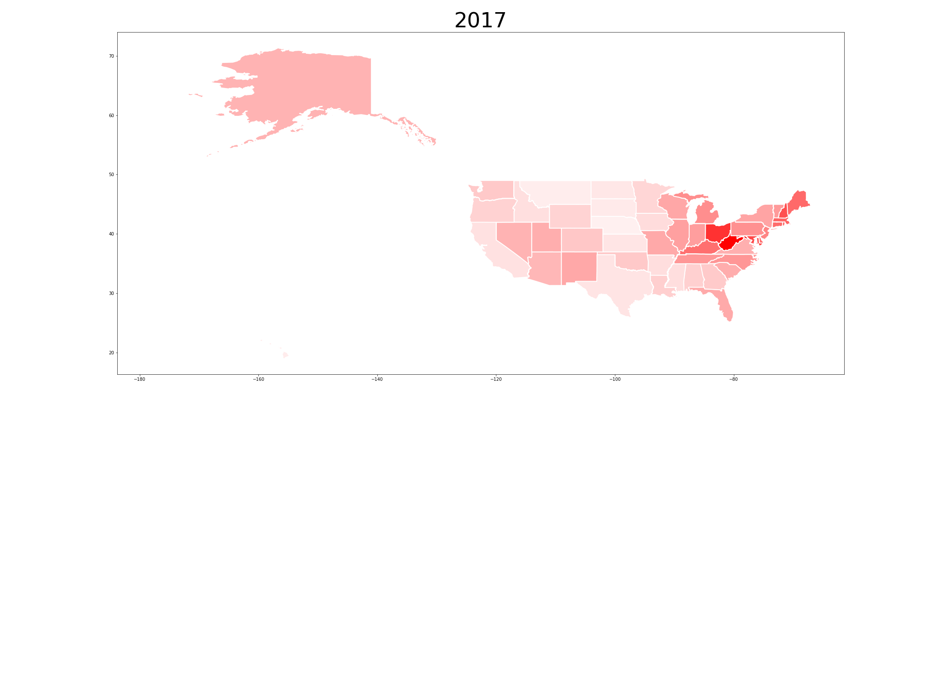
Results: Location
Notes:
matthew
By the end, the west has continued to grow, but nowhere near as quickly as the east, which exploded in opioid usage in the latter half. One interesting note is that there is no "bridge" state; it appears as though opioids originated independently in both the west and east.

Slide 17
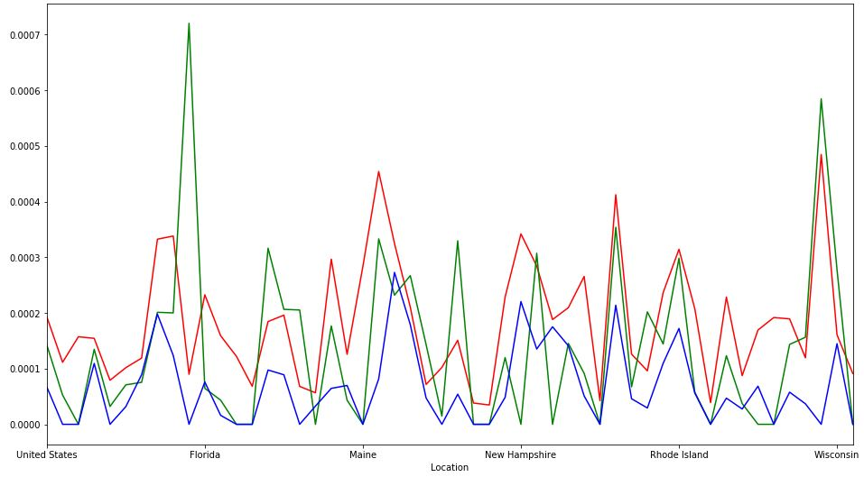
Results: Race/Ethnicity
Each state has similar trend for each trend for all groups
Red: White Death Rate
Green: Black Death Rate
Blue: Hispanic Death Rate
Some outliers:
District of Columbia
West Virginia
Notes:
Brevin:
One of the factors I decided to investigate was the relationship between races and ethnicities to see if certain demographics exhibited higher death rates. From my analysis, I found that all three groups analyzed expressed similar trends (each increase/decrease similarly from state to state).The maximum and minimum death rates for each state vary from different races/ethnicities meaning there is not one clear demographic that has a higher opioid overdose rate.
One interesting thing I found was that the District of Columbia had an unusually high black death rate and West Virginia had an unusually low hispanic death rate. Even after doing a decent amount of research, I couldn’t find the cause of these disparities.

Slide 18
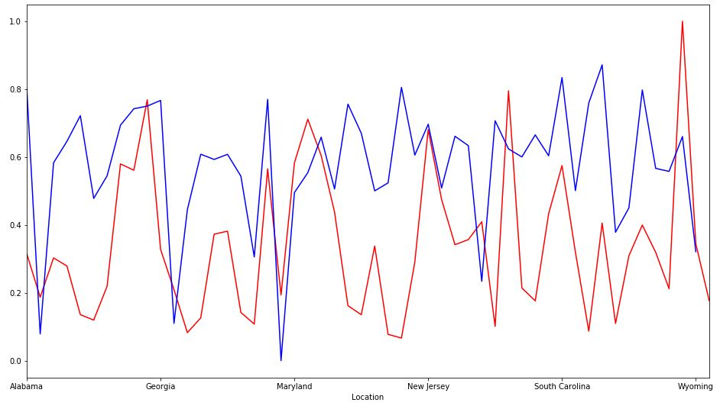
Results: Treatment Facilities
General correlation between opioid related death rate and the lack of treatment facilities
Red: Normalized Opioid Related Death Rate
Blue: 1 - Normalized Number of Treatment Facilities
Potential main cause for high addiction rates is a lack of opioid addiction treatment facilities
Notes:
Brevin:
Opioid addiction, which usually precedes opioid overdose, is classified as a disease and is curable. However, in order to do so, opioid addicts need access to help to overcome this disease. For this reason, I decided to investigate the correlation between the death rate from opioid overdose and the number of treatment facilities per capita in each state. To do this, I normalized the death rates for each state and then plotted that with the normalized number of treatment facilities per capita subtracted from 1 to represent a lack of support facilities in each state. From the data, there seems to be a general trend between these two variables. In states that the death rate is higher, there seems to be a lack of treatment facilities.
This has potential for being one of the main factors for higher opioid overdose rates. When people who live in states with less treatment facilities begin to use opioids and become addicted, they have less access to help that can reduce their addiction before it elevates to a level of overdosing.
Note: to normalize my data, I divided each entry by the max value of that attribute in order to overlay the two data sets on the same range (0, 1). That way the two variables were more comparable while maintaining the magnitude of each data point.

Slide 19
Results: Type of Opioid
Looked at 4 categories: Synthetic, Semi-synthetic, Heroin, Methadone
Synthetic
Created from man-made chemicals rather than natural ingredients
Fentanyl, Ketamine, Synthetic Marijuana, Molly (MDMA), Bath Salts, Synthetic Cocaine, Synthetic Psychedelics
Semi-Synthetic
Made from morphine
Oxycodone, Hydrocodone, Hydromorphone, Oxymorphone
Methadone
A pain reliever; doesn’t induce a high
Mostly used to reduce withdrawal symptoms for addicts (mostly heroin and morphine addicts)
Heroin
Synthesized from morphine
Notes:
Neelie
My data was categorized by four major types of opioids : synthetic, semi synthetic, heroin and methadone. All four of these are opioids but they all are different in their own way.
Synthetic drugs are the newest type of drug and is stronger than any of the other three. This is because these drugs are man-made drugs made from chemicals rather than natural ingredients. They have been synthesized for the sole purpose of inducing an extremely addictive high. Examples for this include Fentanyl, Ketamine, Synthetic Marijuana, Molly (MDMA), Bath Salts, Synthetic Cocaine, and Synthetic Psychedelics.
Semi-synthetic drugs are drugs that are synthesized from morphine. They are often prescribed to patients after surgery as they are pain killer medications. These opioids are at high risk for addiction. Examples include Oxycodone, Hydrocodone, Hydromorphone, and Oxymorphone.
Methadone is a pain reliever and does not induce a high unlike some of the other opioids on the list. Interestingly enough, methadone is widely used to wean heroin and morphine addicts off of their drug of choice.
Heroin is a drug also synthesized from morphine and has a has a high potential for abuse. Not only does heroin heroin reduce pain, but it also induces a highly addictive high. This is what makes heroin so deadly.

Slide 20
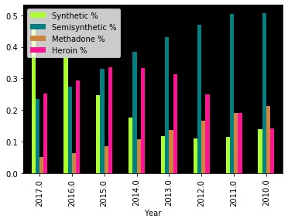
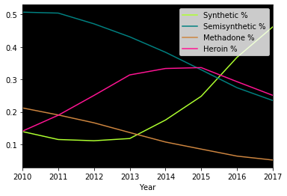
Drug Trends Over Time
Notes:
Neelie
These two graphs pull from the same data and display the same information but in different ways. Essentially, I plotted the rate of opioid overdoses categorized by synthetic, semi-synthetic, methadone, and heroin, over the course of 7 years (2010-2017). The results show a steady increase in synthetic overdoses, a steady decrease in semi-synthetic and methadone overdoses, and a peak in heroin overdoses right around 2015. This goes to show that synthetic drugs have taken over the drug scene and that they have taken over semi-synthetic drugs as the ‘drug of choice’.

Slide 21
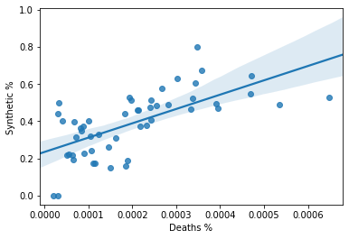
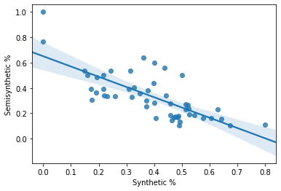
The Danger of Synthetics
Notes:
Neelie
Next, I decided to look at the correlation between different rates of data.
The first graph on the left shows the correlation between the rate of overdoses in the United States and the percentage amount of overdoses caused by Synthetic drug usage. Here, it is clear that synthetic drugs are dangerous, addictive and increasingly causing more deaths.
The graph to the right shows the correlation between the percentage of overdoses caused by Synthetic drug usage in the United States and the percentage of overdoses caused by Semisynthetic drug usage. Here, it is clear that as synthetic drugs are on the incline, semisynthetic drugs are on the decline. This means people are most likely switching out from semi synthetic drugs to synthetic drugs. This is a dangerous trend as synthetic drugs are stronger and easier to overdose on.

Slide 22
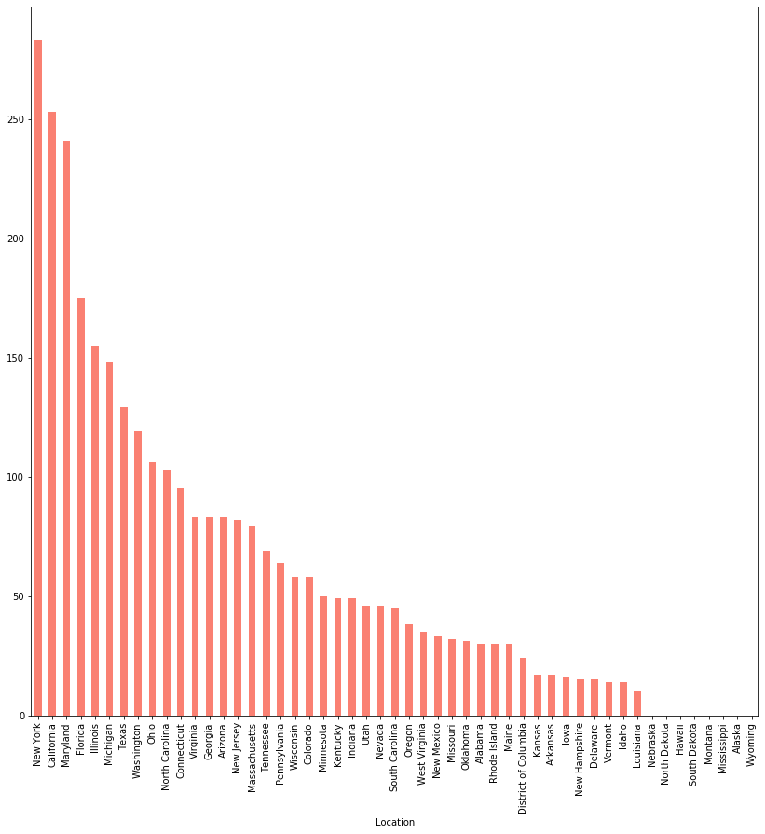
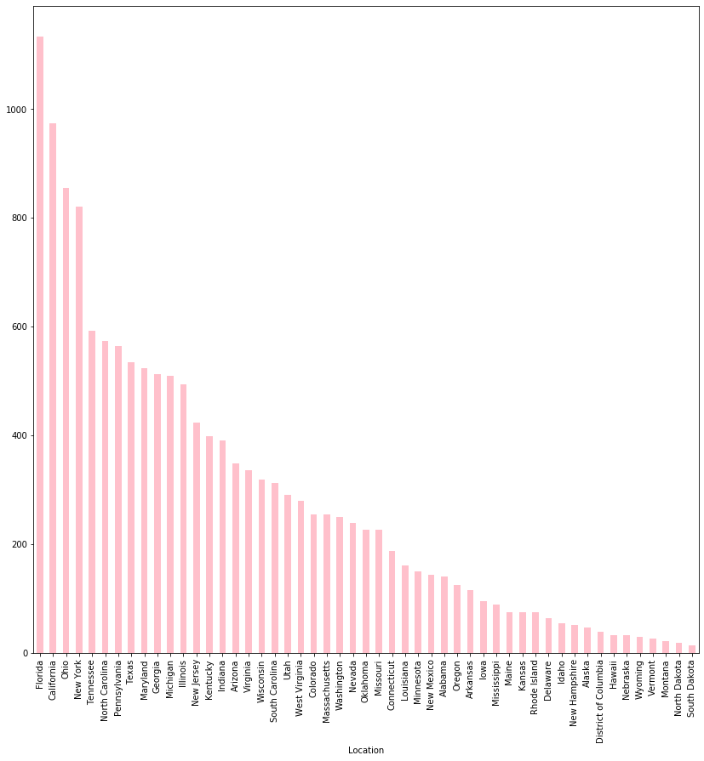
Trends in Drugs Per State
Methadone
Semisynthetic
Notes:
Neelie
To the left, we have the number of overdoses for semisynthetic drugs per state for the most recent year (2017). Florida, California, Ohio, and NY rank among the top.
To the right, we have the number of overdoses for methadone per state for the most recent year (2017). NY, California, Florida, and Maryland rank among the top.
Note that the graphs are not to scale compared to each other. The x axis scaling factors are different.

Slide 23
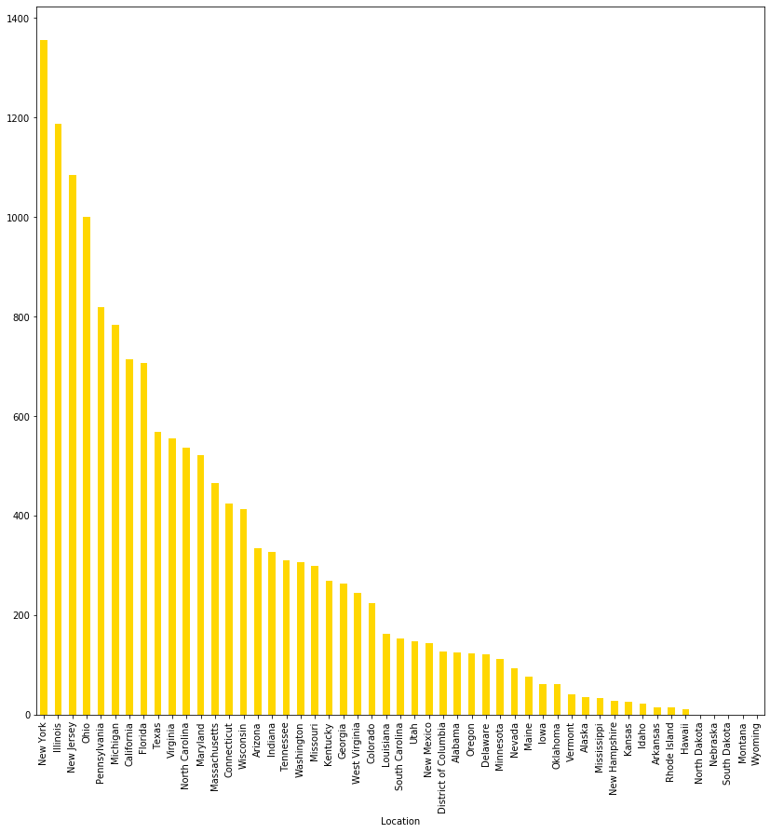
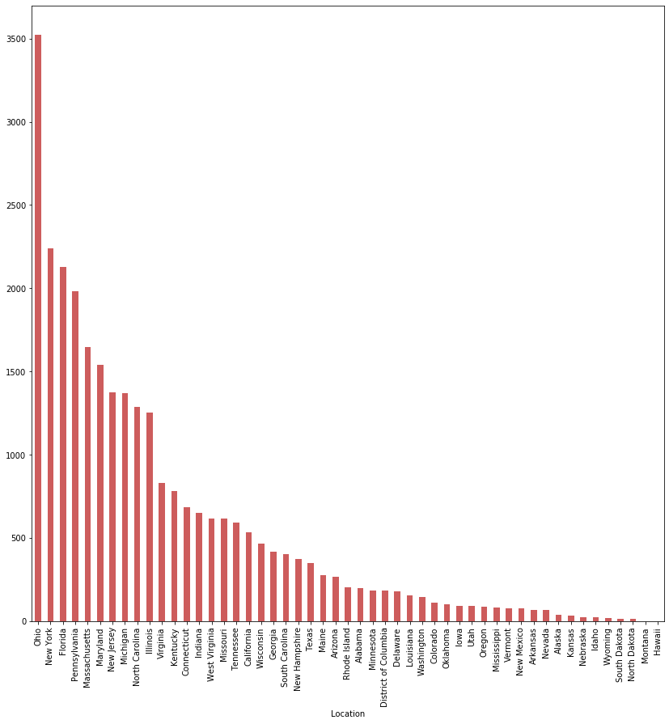
Trends in Drugs Per State
Heroin
Synthetic
Notes:
Neelie
To the left, we have the number of overdoses for heroin per state for the most recent year (2017). NY, Illinois, NJ, and Ohio rank among the top.
To the right, we have the number of overdoses for synthetic drugs per state for the most recent year (2017). Ohio, NY, Florida, and Pennsylvania rank among the top. What is interesting is that for synthetic overdoses, Ohio is in the lead by a significant amount. It is a about a third larger than the second largest user. No other overdose ranking has a gap that large, especially between the top two states.
Again, note that the graphs are not to scale compared to each other. The x axis scaling factors are different.

Slide 24
Results: Type of Opioid
Rise in trend of synthetic drugs
Synthetic drugs are more dangerous than the previous popular type (semi-synthetic) and is causing more overdoses
People are switching out semisynthetic drugs for synthetic drugs
Ohio has the greatest issue with this by far
Florida, Ohio, California, and New York repeatedly come up for highest amount of users
Notes:
Neelie
As previously states, there is a clear rise in the trend of synthetic drugs. Synthetic drugs are far more dangerous than semisynthetic since they cause more overdoses. Lastly, Florida, Ohio, California, and New York all rank among the top for number of overdoses regardless of the type.

Slide 25
Major Issues
Data was collective, not discrete points
Couldn’t group by attribute
Difficult to utilize decision trees, kmeans, etc.
Found combining the data and finding a cohesive story/path to follow difficult
Data was incomplete
Difficult to track illegal substances
Notes:
Kathi
Some major issues we ran into with this project mainly centered around our data. Content wise this data had everything we were looking for. However, the formatting in the end turned out to be a bit of a barrier. The data was already grouped into separate groups (age, gender, race, opioid type) which, while useful in some regards, made it unusable for the classification methods we learned such as decision trees, kmeans, etc.
Since the data was already clustered into these separate categories, it made it difficult to create a cohesive story to tell in the end. As a result, we have a rather disjoint, but collective, progression of analysis.
An issue unique to our topic of study though is the fact that illegal acts are somewhat difficult. While opioid use isn’t necessary illegal, use of it without a prescription is, and it’s reasonable to assume that a significant portion of the opioid crisis arises from illegal use.

Slide 26

What Took the Most Time?
Finding the data
Deciding which datasets to use
Figuring out goals
Determining a specific focus
Crafting cohesive stories
Notes:
matthew
The largest time sink in our project was figuring out which datasets to use. There are many opioid datasets online, but none of them are in an ideal format. We spent a great deal of time wrestling with which data to use, both at the start of the project as well as around the middle, when we considered branching out.
Aside from that, we struggled to figure out exactly what we were doing with the data we did have. Given how large the issue is, we weren't sure what goals to set. As a result we struggled to maintain a clear focus; you can see this in our results, which are broken up by demographic. This lack of a clear vision also made it difficult to develop concrete stories.

Slide 27
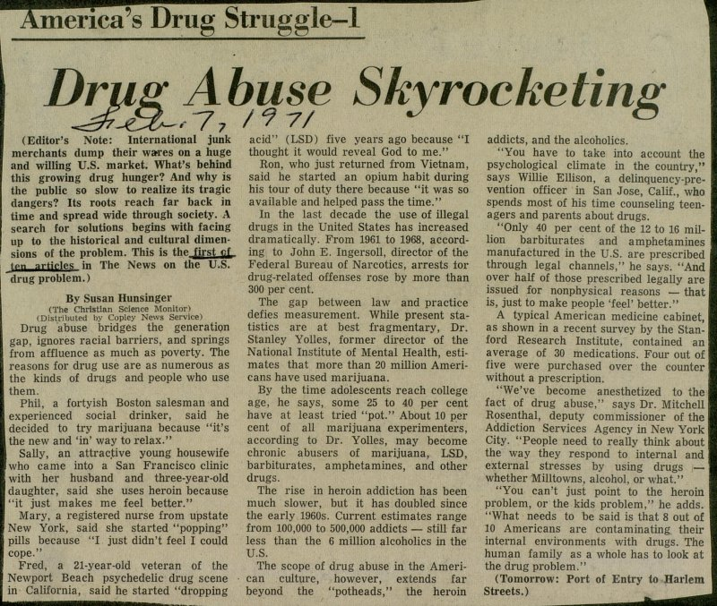
If you had to do this project again, how would you do it?
Find better data
Data composed of individual records
Data containing all attributes together
Larger data timeframe
Develop a more cohesive/concrete story
Tie results in more closely with news
Notes:
Kathi
If we could turn back the clock and do some things over again, the first thing would definitely be to find data with individual records over multiple kinds of attributes. This would allow us to use other methods and models like classifiers. It would also allow us to craft a more complete and cohesive analysis and story to tell.
Additionally, it would be interesting to have data over a larger time frame. Specifically, more recent data as our analysis here seems to show the issue is accelerating. Of course, this is difficult to attain, as it can take time for this sort of information to be compiled accurately.
While our analysis does incorporate outside events and information, it would be interesting to try to pinpoint more specific new stories that tie in with our trends. This not only validates our analysis, but provides a greater context and appreciation of the results.

Slide 28
What are your odds of overdosing on opioids? Find out now!
Find out your chance of dying!! Woo hoo!
https://opioddeathchance.firebaseapp.com/
Notes:
Kathi
While we were unable to use a naive bayes classifier, we were able to use some naive assumptions on the raw numbers, similar to the way we did in class - assuming independence of each of the traits we could pull from our data. We used the values from the 2017 (most recent) data set to do this. While this is certainly a very naive assumption, it did allow us to calculate some probabilities of death by opioid overdose given particular traits. Using these calculated values, Neelie then made a web application so that you could put in traits and determine the “naive” likelihood of death by opioid overdose given those traits.
Neelie
I created this web application in CSS, HTML, and Javascript. I used Firebase to host and deploy it.

Slide 29

Datasets
Overall/by demographics, 2000-2017: https://www.kff.org/state-category/health-status/opioids/
By county, 2010/2015: https://data.world/associatedpress/opioid-prescriptions-2010-2015
General drug use: https://www.samhsa.gov/data/report/supplemental-nsduh-opioid-tables
Notes:
Brevin:
The datasets that we used mainly came from the KFF (Kaiser Family Foundation) database. As mentioned, this database posed some problems for our analysis. The other two databases used were for the purpose on gathering data on how opioid were prescribed over time.

Slide 30
Questions?
Notes:
3 2 1 Q U E S T I O N S

